Slide 1
Solidity

Slide 2
Solidity
Solidity is a language to define Ethereum contracts.
It uses C syntax for the most part, not unlike javascript.
Instead of classes, Solidity defines contracts.
An Ethereum contract is like a class.
Instead of methods, Solidity defines functions.
A function is like a method, with defined accessibility, parameters and return value (or values).
A contract may have any number of functions.
Comprehensive documentation can be found at
https://solidity.readthedocs.io/en/latest/

Slide 3
Solidity
A contract can have a constructor which is run by the owner, and that owner is typically saved.
Functions may be programmed to only be accessible to that owner.
A contract can also have state variables, including arrays such as those mapping all users to values.
These can be used for purposes such as storing account values.

Slide 4
Version
Versioning is particularly important in Solidity due to the rapid development of the platform and the language.
Solidity contract source files should start with a version statement (“pragma”) specifying the compiler version(s) with which it is compatible.
pragma solidity ^0.5.0;
Compiler releases have a changelog that will indicate any breaking changes.

Slide 5
Version
pragma solidity ^0.4.0;
The 0.4.0 indicates that the source file will not compile with a compiler earlier than version 0.4.0, and the ^ indicates that it will also not work on a compiler starting from version 0.5.0.
Many tutorial examples online use versions in the 0.4 or 0.5 families
There were a number of breaking changes introduced with the 0.5 family in 2018 (constructor, constant function, address payable, …). So some of these 0.4.x tutorials will need modification to work with later families.
The 0.6 (December 2019), 0.7 (July 2020) and 0.8 (December 2020) families also each introduced a number of breaking changes
The most recent versions are 0.8.x (as can be seen in the Remix compiler version ddl); 0.8.2 as of March 2021
https://github.com/ethereum/solidity/releases

Slide 6
Version Ranges
The pragma version specification can be complex including a range or multiple ranges
A range is a set of operators (<, <=, >, >=, =) which specify versions that satisfy the range.
If no operator is specified, then equality is assumed
A space is an “and” while || is an “or”
For example,
pragma solidity >=0.4.25 <0.6.0;
Would compile with version 0.4.25 and any subsequent version prior to 0.6.0

Slide 7
Comments
Comment syntax is the same as for most C-based languages:
Single-line comments (//) and multi-line comments (/*...*/) are possible.
// This is a single-line comment.
/*
This is a multi-line
comment.
*/

Slide 8
Contracts
Contracts in Solidity are similar to classes in object-oriented languages.
Contracts can contain State Variables, Functions, Function Modifiers, Structs, Enums, and Events.
Solidity supports inheritance via the “is” keyword following the contract name in the contract declaration statement (in place of “extends” in Java or “:” in other languages)
Contract myContract is myBase {
…

Slide 9
Contracts
Solidity supports multiple inheritance by specifying multiple base classes separated by commas in the contract declaration.
Internally it’s done by effectively copying the code.
When a contract inherits from multiple contracts, a single contract is created on the blockchain, and the code from all the base contracts is effectively copied into the created contract.
All function calls are virtual, which means that the most derived function is called, except when the contract name is explicitly given.
The general inheritance system is very similar to Python’s, especially concerning multiple inheritance.

Slide 10
Constructors
A Solidity constructor is the same concept as a constructor in object oriented languages such as Java: executed upon creation or instantiation.
They are optional.
In versions prior to 0.4.22, the constructor was defined as a function with the same name as the contract.
Starting with version 0.4.22, the keyword “constructor” could also be used to define a constructor.
As of 0.5.0 constructors must be declared with the “constructor” keyword and a function with the same name is a compilation error.

Slide 11
Base Constructors
Derived contracts need to provide all arguments needed for the base constructors.
This can be done in two ways:
If the arguments are static they can be defined in the contract statement
Contract myContract is myBase(args) { …
The other is in the way to define the call to the base constructor in the child constructor definition
Contract myContract is myBase {
constructor myContract(params) public myBase(args) { …

Slide 12
Control Statements
Most of the control statements from C-based languages like Java and JavaScript are available in Solidity (except for switch and goto).
So there is:
if, else, while, do, for, break, continue, return, ? :, with the usual functionality.
Similar to languages like Java, parentheses can not be omitted for conditionals, but curly braces can be omitted around single-statement bodies.

Slide 13
State Variables
State variables are values which are permanently stored in contract storage.
pragma solidity ^0.4.0;
contract SimpleStorage {
uint storedData; // State variable
// ...
}

Slide 14
Types
Solidity is a statically typed language, which means that the type of each variable needs to be specified, or at least deducible, at compile-time.
Solidity provides several elementary types which can be combined to form complex types, for example in Structs.
Solidity has both value types and reference types
Value Types
The types on the immediately following slides are value types meaning variables of these types will always be passed by value, i.e. they are always copied when they are used as function arguments or in assignments.

Slide 15
Value Types: Booleans
bool: The possible values are constants true and false.
Operators (similar to most C-based languages):
! (logical negation),
&& (logical and), || (logical or) : both apply short-circuiting rules
== (equality), != (inequality)
Note that there is no type conversion from non-boolean to boolean types as there is in C and JavaScript, so if (1) { ... } is not valid Solidity.

Slide 16
Value Types: Integers
Solidity defines signed and unsigned integers of various sizes.
uint8 to uint256 in steps of 8 (unsigned integer from 8 up to 256 bits)
int8 to int256 in steps of 8 (signed integers)
uint and int are aliases for uint256 and int256, respectively.
Integer operators are similar to many C-based languages:
Comparisons: <=, <, ==, !=, >=, > (evaluate to bool)
Bitwise operators: &, |, ^ (exclusive or), ~ (negation)
Arithmetic operators:
+, -, unary -,unary +,
*, /, % (remainder), ** (exponentiation),
<< (left shift), >> (right shift)

Slide 17
Integer Arithmetic
Addition, Subtraction and Multiplication
Addition, subtraction and multiplication have the usual semantics.
But you have to be careful of potential overflows:
They wrap in two’s complement representation (-1 is all bits set to 1), meaning that for example
uint256(0) - uint256(1) == 2**256 - 1.
You have to take these overflows into account when designing safe smart contracts. (there are SafeMath libraries by Open Zeppelin *)
Note: as of version 8, overflows and underflows are prevented and reverted by default (with checking adding a bit of gas), unless they are in an unchecked block.
https://github.com/ConsenSysMesh/openzeppelin-solidity/blob/master/contracts/math/SafeMath.sol

Slide 18
Integer Arithmetic
Addition, Subtraction and Multiplication
And you have to be careful of unsigned vs signed, and casting of one to the other
The expression -x is equivalent to (T(0) - x) where T is the type of x.
This means that -x will not be negative if the type of x is an unsigned integer type.

Slide 19
Integer Arithmetic
Division
Since the type of the result of an operation is always the type of one of the operands, division on integers always results in an integer.
Note: In Solidity, integer division rounds towards zero even for negatives
This mean that int256(-5) / int256(2) == int256(-2).
Note that in contrast, division on literals results in fractional values of arbitrary precision.
Modulo
The modulo operation a % n yields the remainder r after the division of the operand a by the operand n,

Slide 20
Shorthand Operators
If a is a variable or something that can be assigned to, the following operators are available as shorthand operators (similar to most C-based languages)
a += e is equivalent to a = a + e
The operators -=, *=, /=, %=, |=, &= and ^= are defined accordingly.
a++ and a-- are equivalent to a += 1 and a -= 1 respectively, but the expression itself still has the previous value of a.
In contrast, --a and ++a have the same effect on a but return the value after the change.

Slide 21
Operators Order of Precedence
Essentially identical to most C-based languages:
Postfix: ++, --, new, array indexing, member access, parentheses
Prefix: ++, --, Unary: +, -, delete, !, ~
Exponentiation: **
Multiplication, division and modulo: *, /, %
Addition and subtraction: +, -
Bitwise operators: <<, >> then & then ^ then |
Inequality operators: <, >, <=, >= then equality: ==, !=
&& then ||
Ternary operator<conditional> ? <if-true> : <if-false>
Assignment operators=, |=, ^=, &=, <<=, >>=, +=, -=, *=, /=, %=

Slide 22
Value Types: Fixed/Decimal
Fixed Point Numbers
Fixed point numbers are not fully supported natively by Solidity.
(1 Ether is 10¹⁸ Wei, so Wei can always be used instead of Ether decimals.)
However a number of libraries have been developed to provide floating point functionality in Solidity:
https://ethereum.stackexchange.com/questions/83785/what-fixed-or-float-point-math-libraries-are-available-in-solidity

Slide 23
Value Types: Address
There are two types of addresses, which are very similar:
address: Holds a 20 byte value (size of an Ethereum address).
address payable: Same as address, but with the additional members transfer and send.
The idea behind this distinction is that address payable is an address you can send Ether to, while a plain address cannot be sent Ether.
The distinction between address and address payable was introduced with version 0.5.0.
Members of Addresses
balance and transfer
balance is a property and returns the balance of an address
transfer is a function which sends Ether (in units of wei) to an address

Slide 24
Fixed Size Byte Strings
Fixed-size byte strings or “byte arrays”
bytes1, bytes2, bytes3, …, bytes32; byte strings of a specified length
byte is an alias for bytes1.
Operators:
Comparisons: <=, <, ==, !=, >=, > (evaluate to bool)
Bit operators: &, |, ^ (bitwise exclusive or), ~ (bitwise negation), << (left shift), >> (right shift)
Index access: x[k] returns the k^{th} byte (0 relative, read-only).
Members:
.length yields the fixed length of the byte array (read-only).

Slide 25
Dynamic Sized Strings
Dynamically-sized byte string or byte array
bytes: Dynamically-sized byte array. Not a value-type!
string: Dynamically-sized UTF-8-encoded string. Not a value-type!
Use bytes for arbitrary-length raw byte data and string for arbitrary-length string (UTF-8) data.
If it’s possible to limit the length to a certain number of bytes, a fixed length array, bytes1 to bytes32, would be better because they are much more efficient (and cheaper).

Slide 26
Strings
String Literals
String literals are written with either double or single-quotes ("foo" or 'bar').
"foo" represents three bytes (not four like some languages with an end byte).
As with integer literals, their type can vary, but they are implicitly convertible to bytes1, …, bytes32, if they fit, to bytes and to string.
String literals support escape characters, such as \n, \xNN and \uNNNN.
\xNN takes a hex value and inserts the appropriate byte
\uNNNN takes a Unicode codepoint and inserts an UTF-8 sequence.

Slide 27
Hexadecimals
Hexadecimal Literals
Hexademical Literals are prefixed with the keyword hex and are enclosed in double or single-quotes (hex"001122FF").
Their content must be a hexadecimal string and their value will be the binary representation of those values.
Hexademical Literals behave like String Literals and have the same convertibility restrictions.

Slide 28
Enums
Enums are one way to create a user-defined type in Solidity.
They are explicitly convertible to and from all integer types (unlike Java, but like some other C-based languages) but implicit conversion is not allowed.
The explicit conversions check the value ranges at runtime and a failure causes an exception.
Enums needs at least one member.
see the following example

Slide 29
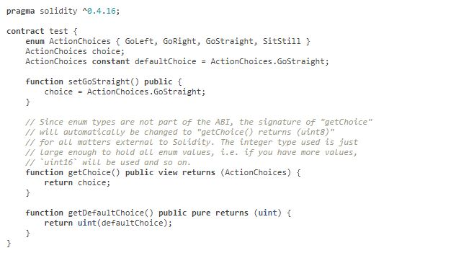

Slide 30
Functions
Functions are the executable units of code within a contract, equivalent to methods in classes.
pragma solidity ^0.4.0;
contract SimpleAuction {
function bid() public payable {
// Function // ... }
}
Function Calls can happen internally or externally and have different levels of visibility

Slide 31
Modifiers
pure for functions: Disallows modification or access of state – as of v0.4.17. Best to use if state is not even read.
view for functions: Disallows modification of state – as of v0.4.17. Best to use if state is read but not updated.
payable for functions: Allows them to receive Ether together with a call.
constant for state variables: Disallows assignment (except initialization), does not occupy storage slot.
constant for functions: Same as view. (as of 0.5.0 view or pure should be used for functions, rather than constant)

Slide 32
Function Modifiers
Function modifiers are a feature in Solidity that is not common in other languages
Function modifiers can be used to limit or effectively change the behavior of functions.
For example, they can automatically check a condition prior to executing the function, using a require statement or checking a condition and using a throw if access should be denied.
Modifiers are inheritable properties of contracts and may be overridden by derived contracts.
https://solidity.readthedocs.io/en/latest/contracts.html#function-modifiers

Slide 33
Input and Output Parameters
- Multiple output parameters are allowed in Solidity, as well as the usual multiple input parameters:
function multOpFunc(int8 p1, int8 p2, int8 p3) pure returns (uint8, uint8) {
uint8 test1 = uint8(p1 + p2);
uint8 test2 = uint8(p2 + p3);
return (test1, test2);
}
function view useMultOp(){
…
var (a, b) = multOpFunc(ip1, ip2, ip3);
…
}

Slide 34
Memory vs Storage
Data location
Every complex type, i.e. arrays and structs, has an additional annotation, the “data location”, about whether it is stored in memory or in storage.
Depending on the context, there is always a default, but it can be overridden by appending either storage or memory to the type.
The default for function parameters (including return parameters) is memory,
The default for local variables is storage and the location is implicitly storage for state variables.

Slide 35
Reference Types
Reference Types
Complex types, which do not always fit into 256 bits have to be handled more carefully than value types.
Copying them can be quite expensive, so the decision of whether they should be defined as stored in memory (like function variables, which are not persisting) or storage(like class or instance variables which are persisted as part of state) can be important.
Storage variables are always passed by reference.

Slide 36
Arrays
Arrays can have a compile-time fixed size or they can be dynamic.
An array of fixed size k and element type T is written as T[k], an array of dynamic size as T[].
As an example, an array of 5 dynamic arrays of uint is uint[][5]
note that the declaration notation is reversed when compared to some other languages like Java.
But access is similar to other languages: To access the second uint in the third dynamic array, you use x[2][1] (indices are zero-based and access works in the opposite way of the declaration).

Slide 37
Arrays
Array Members
length: Arrays have a length member to hold their number of elements.
Dynamic arrays can be resized in storage (not in memory) by changing the .length member.
This does not happen automatically when attempting to access elements outside the current length.
The size of memory arrays is fixed (but dynamic, i.e. it can depend on runtime parameters) once they are created.
push: Dynamic storage arrays and bytes (not string) have a member function called push that can be used to append an element at the end of the array. The function returns the new length.

Slide 38

Structs
Solidity provides a way to define new types in the form of structs, similar to many C-based languages.
A struct is like a lightweight data-only class in that is has the equivalent of fields, but (usually) no methods or constructors.
Structs can be initialized by member order, or by member name:

Slide 39
Mappings
Mapping types are declared as mapping(_KeyType => _ValueType).
_KeyType can be almost any type except for a mapping, a dynamically sized array, a contract, an enum and a struct. It is effectively the lookup key for the mapping.
_ValueType can be any type, including mappings.
Mappings can be seen as hash tables which are virtually initialized such that every possible key theoretically exists and is mapped to a value whose byte-representation is all zeros: a type’s default value.
The similarity ends here, though: The key data is not actually stored in a mapping, only its keccak256 hash used to look up the value.
Because of this, mappings do not have a length or a concept of a key or value being “set”.
And mappings cannot be iterated over.

Slide 40
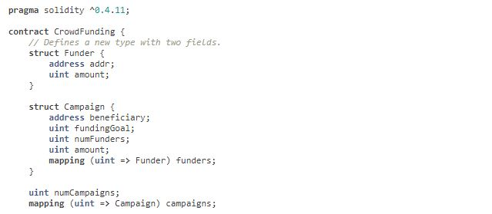

Slide 41
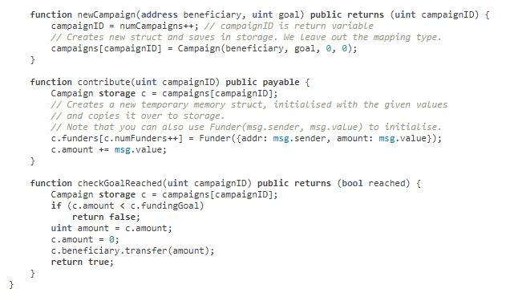

Slide 42
Initialize Values
delete
“delete a;” assigns the initial value for the type to a.
For integers it is equivalent to a = 0, but it can also be used on arrays, where it assigns a dynamic array of length zero or a static array of the same length with all elements reset.
For structs, it assigns a struct with all members reset.
contract DeleteExample {
uint data;
function f() public {
uint x = data;
delete x; // sets x to 0, does not affect data
delete data; // sets data to 0, does not affect x
…

Slide 43
Type Conversion
Implicit Conversions
If an operator is applied to different types, the compiler tries to implicitly convert one of the operands to the type of the other, as is done for assignments.
In general, an implicit conversion between value-types is possible if it makes sense semantically and no information is lost:
uintn to uintm, intn to intm and uintn to intm where m>n,
Also, unsigned integers can be converted to bytes of the same or larger size, but not vice-versa.
Any type that can be converted to uint160 can also be converted to address.
Explicit Conversions
If the compiler does not allow implicit conversion but you know what you are doing, an explicit type conversion is sometimes possible. This may result in unexpected behavior so be sure to test.
uint8 test1 = 1;
int8 test2 = int8(test1);

Slide 44
Implicit Type Specification
Type Deduction
For convenience, it is not always necessary to explicitly specify the type of a variable, the compiler automatically infers it from the type of the first expression that is assigned to the variable:
uint24 x = 0x123;
var y = x;
Here, the type of y will be uint24.
Using var is not possible for function parameters or return parameters.

Slide 45
Units
A literal number can take a suffix of wei, finney, szabo or ether to convert between the subdenominations of Ether, where Ether currency numbers without a postfix are assumed to be Wei, e.g. 2 ether == 2000 finney evaluates to true.
1: wei
10¹²: szabo
10¹⁵: finney
10¹⁸: ether
Some implementations, specifically web.js, have additional denominations, as listed on the following slide.
It’s probably better to stick to those above.

Slide 46
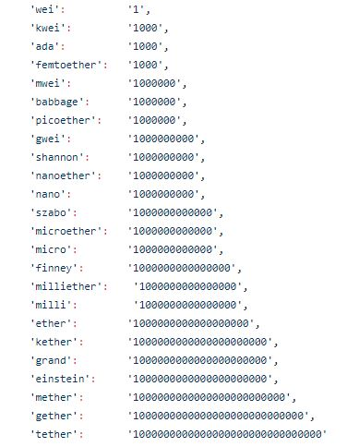

Slide 47
Units
Time Units
Suffixes like seconds, minutes, hours, days, weeks and years after literal numbers can be used to convert between units of time where seconds are the base unit and units are considered naively in the following way:
1 == 1 seconds
1 minutes == 60 seconds
1 hours == 60 minutes
1 days == 24 hours
1 weeks == 7 days
1 years == 365 days

Slide 48
Visibility
Solidity has two kinds of function calls; internal ones that do not create an actual EVM call (also called a “message call”) and external ones that do.
Accordingly, there are four types of visibilities for functions and state variables.
Functions can be specified as being external, public, internal or private, where the default is public.
For state variables, external is not possible and the default is internal.

Slide 49
Visibility
external functions are part of the contract interface, which means they can be called from other contracts and via transactions.
An external function f cannot be called internally (e.g. f() does not work, but this.f() works). External functions are sometimes more efficient when they receive large arrays of data.
public functions are part of the contract interface and can be either called internally or via messages. For public state variables, an automatic getter function is generated.
internal functions and state variables can only be accessed internally (i.e. from within the current contract or contracts deriving from it), without using this.
private functions and state variables are only visible for the contract they are defined in and not in derived contracts.

Slide 50
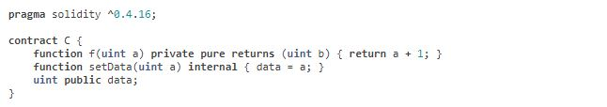
Visibility
Everything that is inside a contract is visible to all external observers. Making something private only prevents other contracts from accessing and modifying the information, but it will still be visible to the whole world outside of the blockchain.
The visibility specifier is given after the type for state variables and between parameter list and return parameter list for functions.

Slide 51
Events
Events allow the convenient usage of the EVM logging facilities, which in turn can be used to “call” JavaScript callbacks in the user interface of a dapp, which listen for these events (e.g. using web3.js contract watch declaration).
In the Solidity source code, to define an event, you mark it as such by preceding it with the event keyword (similar in usage to the function keyword).
You then call or fire the event in the body of whatever function you wish to cause to generate the event.
You may fire events from any function.

Slide 52
Events
Events are inheritable members of contracts. When they are called, they cause the arguments to be stored in the transaction’s log; a special data structure in the blockchain.
Log entries represent the result of events having fired from a smart contract.
Each completed transaction in the blockchain has an attached receipt which contains zero or more log entries.
These logs are associated with the address of the contract and will be incorporated into the blockchain and stay there as long as a block is accessible
Log and event data is not accessible from within contracts (not even from the contract that created them), though there are also low-level logging commands.

Slide 53
Imports
Solidity supports import statements that are very similar to those available in JavaScript
At a global level, you can use import statements of the following form:
import "filename";
This statement imports all global symbols from “filename” into the current global scope
import * as symbolName from "filename";
…creates a new global symbol symbolName whose members are all the global symbols from "filename".
import "filename" as symbolName;
which is equivalent to import * as symbolName from "filename";.

Slide 54
Abstract Contracts
Contracts are marked as abstract when at least one of their functions lacks an implementation as in the following example
contract test { function foo() public returns (bytes32); }
(note that the function declaration header is terminated by ;)
Such contracts cannot be compiled (even if they contain implemented functions alongside non-implemented functions), but they can be used as base contracts.
If a contract inherits from an abstract contract and does not implement all non-implemented functions by overriding, it will itself be abstract.

Slide 55
Interfaces
Solidity also supports interfaces, defined using the “interface” keyword in place of the “contract” keyword.
The functions are defined in the same way as an abstract contract defines unimplemented functions.
An abstract contract in which none of the functions contains an implementation is effectively the same as an interface

